Slide 1


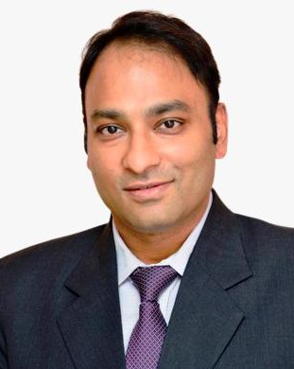
1st National Conference on Tobacco Use among Tribal Communities of India
TUTC 2024
20th-21st July
ALL INDIA INSTITUTE OF MEDICAL SCIENCES, DEOGHAR
Qualifications & Experience:
Dr. Sonu Goel has obtained an MBBS and MD degree in Community Medicine from Indira Gandhi Medical College and Hospital, Shimla, and a Ph.D. degree from Maastricht University, Netherlands and has 25 years of experience in the field of Public Health.
Research Projects & Publications:
Dr. Goel has supervised over 50 national and international projects as the Principal Investigator and is currently leading five ongoing projects. He has published more than 270 research articles in esteemed international peer-reviewed journals.
Awards & Achievements:
He is a recipient of various awards and fellowships, including the fellow of National Academy of Medical Sciences, Young Researcher Award by IAPSM-FORD Foundation, Harcharan Singh Oration Award, Vasudeva Oration Award, JE Park Oration, and was awarded the Public Health Excellence of India by the Hon'ble Union Minister of Health & Family Welfare in 2014.
Work related to Tobacco Control:
He is the Chair of the Tobacco Control Section and leads the MPOWER Research Group of The Union, as well as the NAMS Task Force on Tobacco Control. Additionally, he is the Director of the WHO Awardee E-Resource Centre for Tobacco Control and the Convenor of the Scientific Support Group established by the Ministry of Health and Family Welfare, Government of India.
Dr. Sonu Goel
Professor, DCM & SPH,
Director, e-RCTC, PGIMER, Chandigarh
Adjunct Associate Clinical Professor, School of Medicine,
University of Limerick, Ireland
Honorary Professor,
Human & Health Sciences, Swansea University, United Kingdom

